Slide 1
Vaughn Analysts Inc.
Mayor Vaughn Group:
Taisgaly Vélez
Luis Millet
Rayner Morla
Ricardo Torres

Slide 2
Project Overview
The original dataset had a shape of 23 columns and 6969 rows.
It had a lot of dirty data with lots of null values and duplicate values.
The most relevant columns were:
['Date', 'Year', 'Type', 'Country', 'State', 'Location', 'Activity', 'Name', 'Sex', 'Age', 'Injury', 'Time', 'Species ']
We first browsed the data and then established 6 hypothesis. These were:
Sharks attacks are more common among individuals swimming.
Shark attacks are more common during the afternoon.
Shark attacks are more common if the sharks are provoked.
Sharks are more common to attack males.
Shark attacks are more common during July.
Shark attacks are more common among people under 30 years of age.

Slide 3
Project Overview
As for our business strategy, due to Florida's tourism Governor Ronald Dion DeSantis has contacted Vaughn Analysts Inc. to analyze shark attack data around Florida.
Concentrating in our business proposition and the acceptance or rejection of our hypothesis, we managed to eliminate a lot of data from the dataset and end up with these columns.
['Date', 'Type', 'Activity', 'Sex', 'Age', 'Time']
And now, the real data cleaning began.

Slide 4
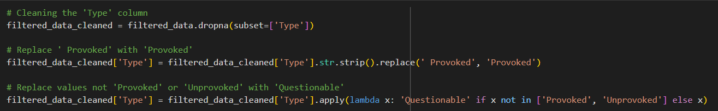
Data Wrangling and Cleaning
A lot of values referred to the same concept but were recorded in different ways or just had a single added space (‘ ‘) to the words. The strip( ) function helped us here.
Also, who can forget about all the NaN (null) values in the data. Thankfully, dropna( ) and fillna( ) helped us a lot.

Slide 5
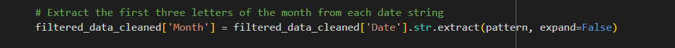
Exploratory Data Analysis
To use the Date values we decided to create a Month column. We created a pattern of recognition for Python to extract the Month information from the Date column. The pattern recognizes the month with the first 3 letter of the month.

Slide 6
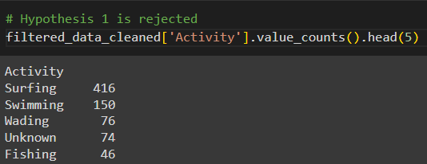
Exploratory Data Analysis

Slide 7
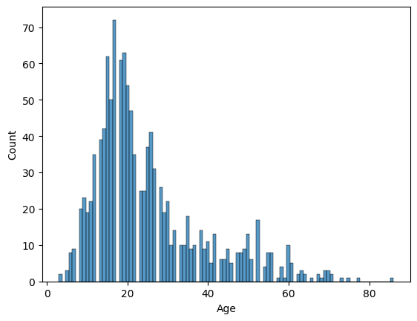
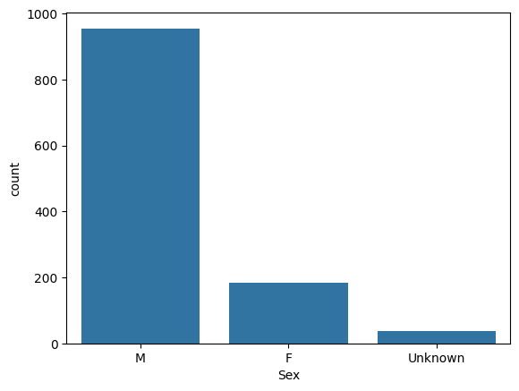
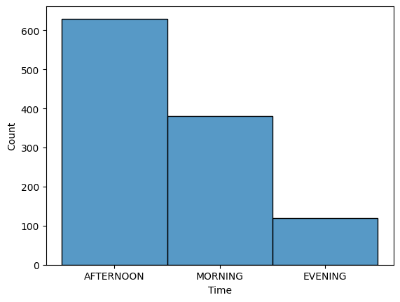
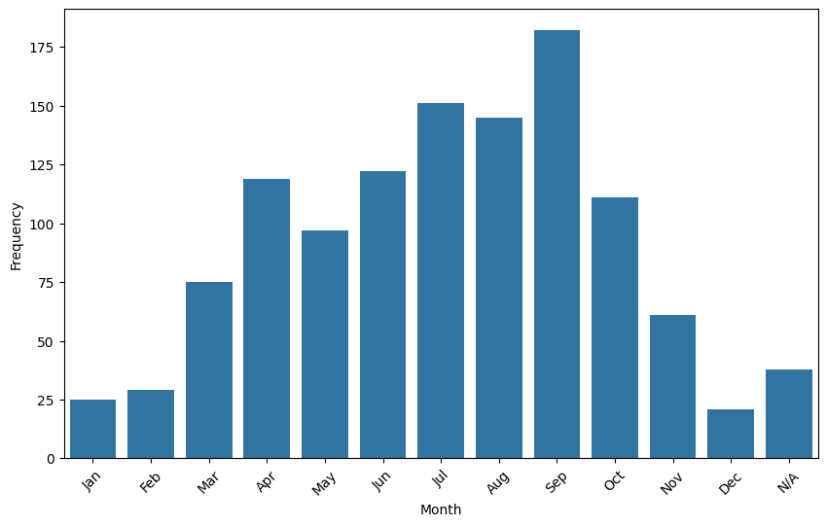
Exploratory Data Analysis
Age Histogram
Sex Bar Chart
Time Histogram
Month Bar Chart

Slide 8
Major Obstacle
A major obstacle was to identifying how to transform the data to answer our hypothesis.
We learned that information can be extracted from certain columns and be used as a broader value.
The Date column was transformed from displaying the day, month and year, to a new column called ‘Month’ with only the month values.
The shape of the data frame after the cleaning was (1176, 7).
Also, the time for completion was a little tight.
We had to work after hours to finish with the cleaning, the analysis, and the presentation. It was hard but we managed to complete a successful project.

Slide 9
Conclusion and Insights
After the data analysis, these were the results:
Sharks attacks are more common among individuals engaging in swimming. (REFUTED)
Shark attacks are more common during the afternoon. (SUPPORTED)
Shark attacks are more common if the sharks are provoked. (REFUTED)
Sharks are more common to attack males. (SUPPORTED)
Shark attacks are more common during July. (REFUTED)
Shark attacks are more common among people under 30 years old. (SUPPORTED)
After the analysis, Governor DeSantis was informed that most of the shark attacks occur primarily:
To people surfing
During the afternoon
Unprovoked sharks
To males
During the month of September
To people under 30 years

Slide 10
Thanks for your attention!

